Slide 1


Music Recommendation System
The
Placeholders
SUBHAM MUDI
ROHAN GHORAI
SOVAN KUMAR DAS
ADRISH BHATTACHARYA

Slide 2

Music Recommendation System
Building a content based music recommendation system:
Content-based filtering uses item features to recommend other items similar to what the user likes, based on their previous actions or explicit feedback.
Why use content based filtering:
The model doesn't need any data about other users, since the recommendations are specific to this user. This makes it easier to scale to a large number of users.
Recommendations are highly relevant to the user
Tech stack used :
Python
HTML
CSS
JavaScript

Slide 3

Our Process
1 | 2 | 3 | 4 | 5
Data Extraction | Data Processing | Build Models | Finding Similarity | Recommendation
Dataset Download Spotify API Feature extraction Data Reshaping | TF-IDF One-Hot Encoding Normalizing Features | Modeling Methods Pipeline | Summarizing Features Cosine Similarity between songs | Best Model Key Learnings
Demonstration
3

Slide 4





Dataset
1 csv file
tracks_with_genres_v4.csv
Test Set
id name
popularity
duration_ms
explicit
artists
release_date
Acousticness
release_year
duration_min
consolidates_genre_lists
Train Set
Name
length
ID
Songs_extra_info
language
genres
Songs
ID
Age
Gender
Members
city
User info
artist
composer
lyricist
4

Slide 5


How to generate recommendations for a song
Details
Connecting to Spotify API.
Data preparation
Feature Engineering
Generate recommendations.
Limitations
Dataset used is quite small(around 6000 songs) which affects the recommendation.
Many genres missing in the dataset or have only a few songs. This affected the recommendation for songs of certain genres.
Algorithm Type
Content based Recommendation
5

Slide 6
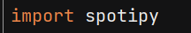
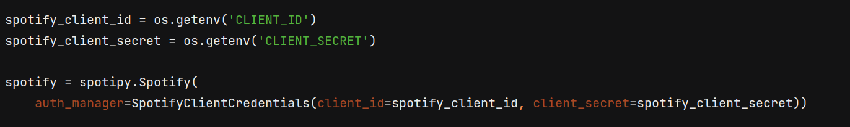
Connecting to Spotify API
Installing Spotipy
Firstly we will install Spotipy using pip. Spotipy is a Python client for the Spotify Web API that makes it easy for developers to fetch data and query Spotify’s catalog for songs.
Type of authorization : Client Credentials flow.
CLIENT_ID and CLIENT_SECRET is stored as environment variables in the .env file.
6

Slide 7











Data Cleaning &
Feature Engineering Pipeline
Join Features
NA → ‘nan’
Merge & Split
Feature Engineering
Imputation & Filling NAs
Encoding Data
Feature Extraction
Labels
7

Slide 8
Data Preparation
The dataset used for this project was taken from Kaggle.
This dataset contains various track features as well as track id, track name, track artists.
The genre column of this dataset is actually given in form of string although it looks like list of strings.
I'm going to put together a regex statement to extract the genres and input into a list.
Now I will retrieve the user track information/data with the help of song name and song artist.
8

Slide 9
Data Preparation
# fetching the information regarding the track that user entered def fetch_track(song_name, song_artist): result = spotify.search(q='track: {} artist: {}'.format(song_name, song_artist), limit=1) # not able to find song (return None) if result['tracks']['items'] == []: return None song_id = result['tracks']['items'][0]['id‘] # retrieving the user tracks features from spotify api track_info = spotify.audio_features(tracks=song_id) track_info = track_info[0] track_data = defaultdict() for key, value in track_info.items(): track_data[key] = value artist_id = result['tracks']['items'][0]['album']['artists'][0]['id‘] artist_info = spotify.artist(artist_id=artist_id) artist_genres = artist_info['genres'] track_data['genres'] = [artist_genres] track_data['artists'] = artist_info['name'] track_data['name'] = result['tracks']['items'][0]['name'] track_data['release_year'] = result['tracks']['items'][0]['album']['release_date'] track_data['popularity'] = result['tracks']['items'][0]['popularity'] track_data['duration_min'] = track_info['duration_ms'] / (1000 * 60) track_data['release_year'] = int(track_data['release_year'][:4]) return pd.DataFrame(track_data)
9

Slide 10
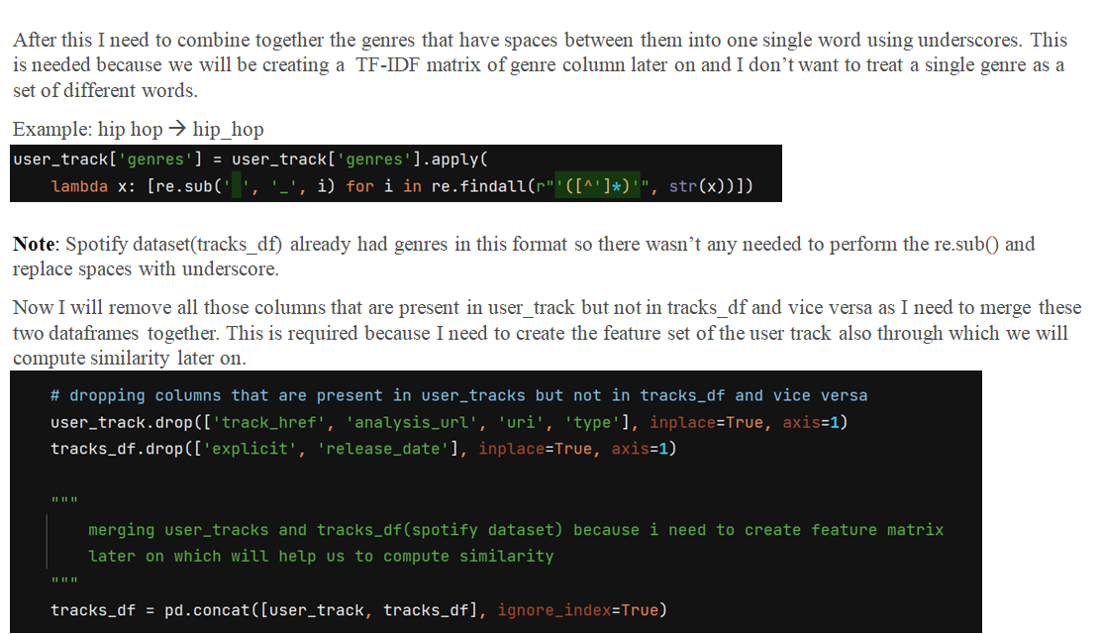
Data Preparation
10

Slide 11
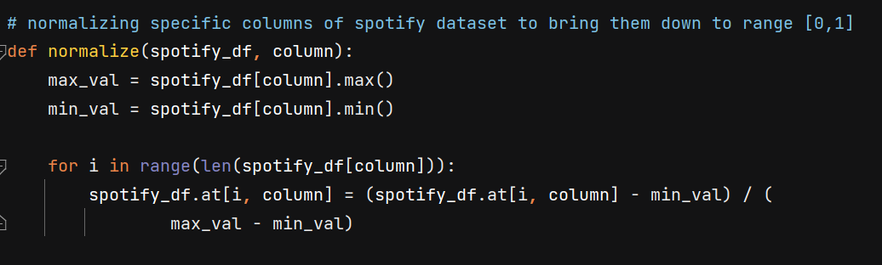
Feature Engineering
Normalizing columns
Create TF-IDF features for genre column
One hot encoding the year column
11

Slide 12
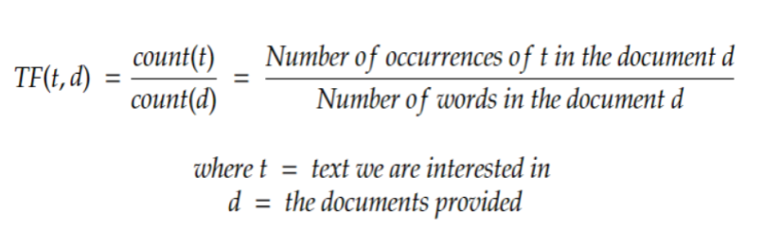
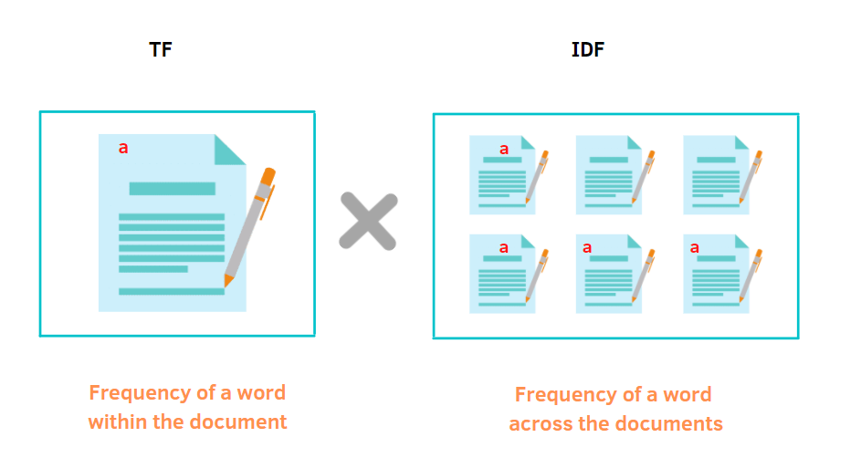
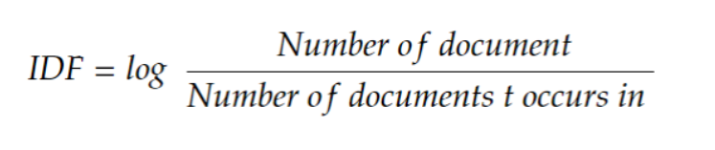
Feature Engineering
The genres in Spotify dataset are not balanced distributed with some genres more prevalent while others are more obscure. In addition, one artist or track could be associated with multiple genres. Hence, we need to weigh the importance of each genre to combat overweighing specific genres while underestimating others.
Therefore, TF-IDF measures are introduced and applied to the genre data. TF-IDF, also known as Term Frequency-Inverse Document Frequency, is a tool to quantify words in a set of documents. The goal of TF-IDF is to show the importance of a word in the documents and the corpus.
The general formula for calculating TF-IDF is:
12

Slide 13
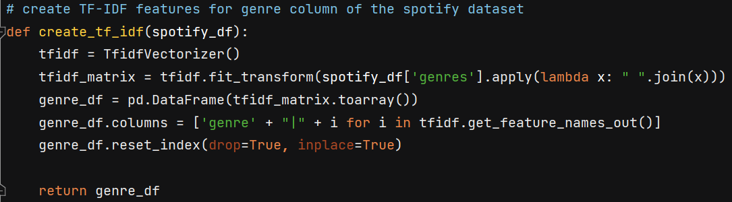
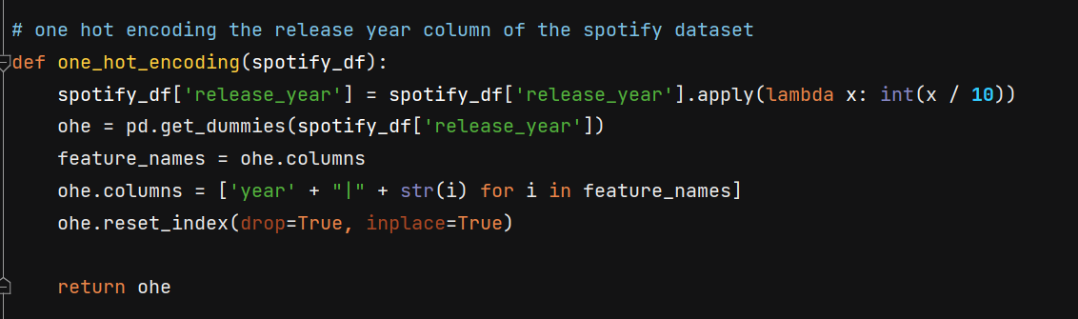
Feature Engineering
Now we need to One Hot Encode the release year column of the dataset. But before doing that I will perform binning on the release year and divide them into bins of 10 years, because any song that is released in this duration is a good recommendation.
Finally after doing all the above mentioned feature engineering we are now ready to group together the final set of useful features which will help us in generating the recommendations.
13

Slide 14
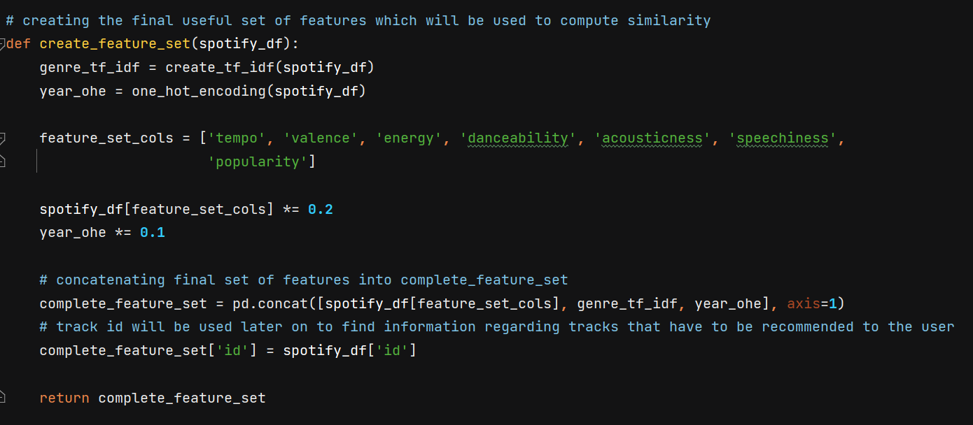
Feature Engineering
One thing to note here is that I have assigned different weights to different feature set by multiplying them with some constant this has been done by testing the model on various inputs in order to generate better recommendations.
14

Slide 15
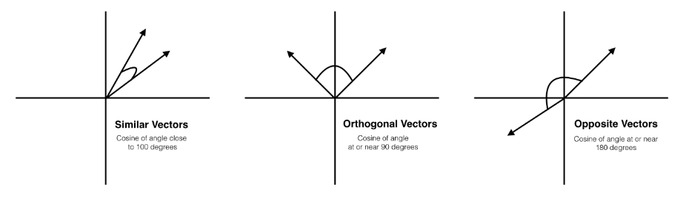
Generate Recommendations
Firstly I need to separate final useful set of user_track feature set from tracks_df( spotify dataset ) as I had merged them together before, this is needed because I need to compute similarity between user_track feature set and tracks_df. This also prevents user track from becoming a possible candidate for final recommendation.
Now to find out the similarity score between user song and tracks present in our dataset. The similarity metric chosen is Cosine similarity.
Cosine similarity is a mathematical value that measures the similarities between vectors. Imagining our songs vectors as only two-dimensional, the visual representation would look similar to the figure below.
15

Slide 16
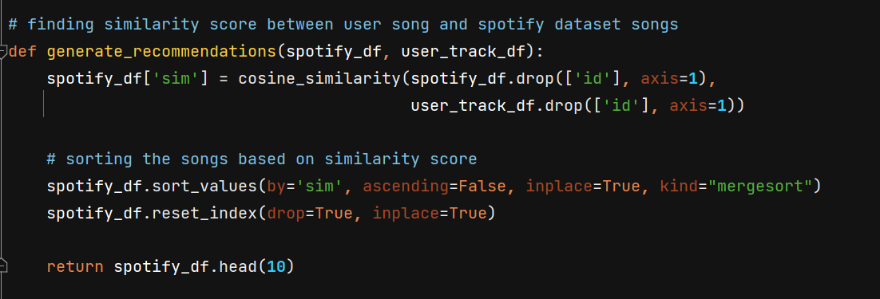
Generate Recommendations
Once the two vectors are pointing generally in the same direction, then they are similar. This implies that a higher value of cos(theta) where theta is the angle between the two vectors, tells us that the songs are similar.
The generate recommendation function computes similarity between the user track and spotify dataframe and then sorts the spotify dataframe on the basis on decreasing similarity score. The type of sorting used is Merge Sort because of its nlogn time complexity.
Finally it returns the top 10 songs from the spotify dataframe after sorting.
16

Slide 17
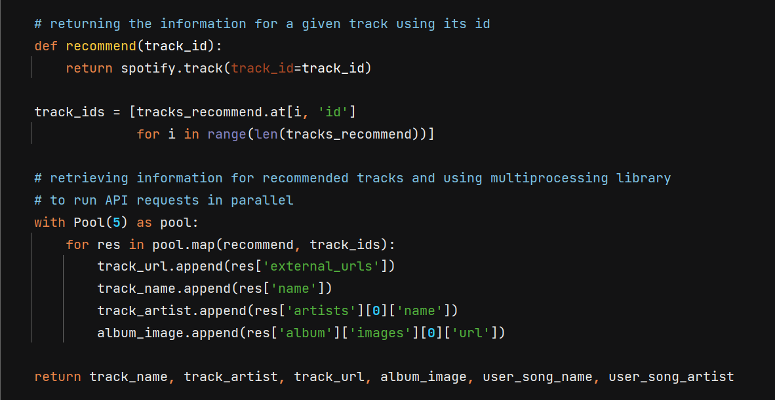
Generate Recommendations
Now we have the top 10 songs that we want to recommend to the user. The name, artist, album image and spotify link of the tracks will be retrieved through spotify API and will be shown to the user on the website. Here I’ve used the multiprocessing module to run the API requests in parallel, this helped to reduce the runtime of the application.
17

Slide 18
Generate Recommendations
Now we have the top 10 songs that we want to recommend to the user. The name, artist, album image and spotify link of the tracks will be retrieved through spotify API and will be shown to the user on the website. Here I’ve used the multiprocessing module to run the API requests in parallel, this helped to reduce the runtime of the application.
18

Slide 19
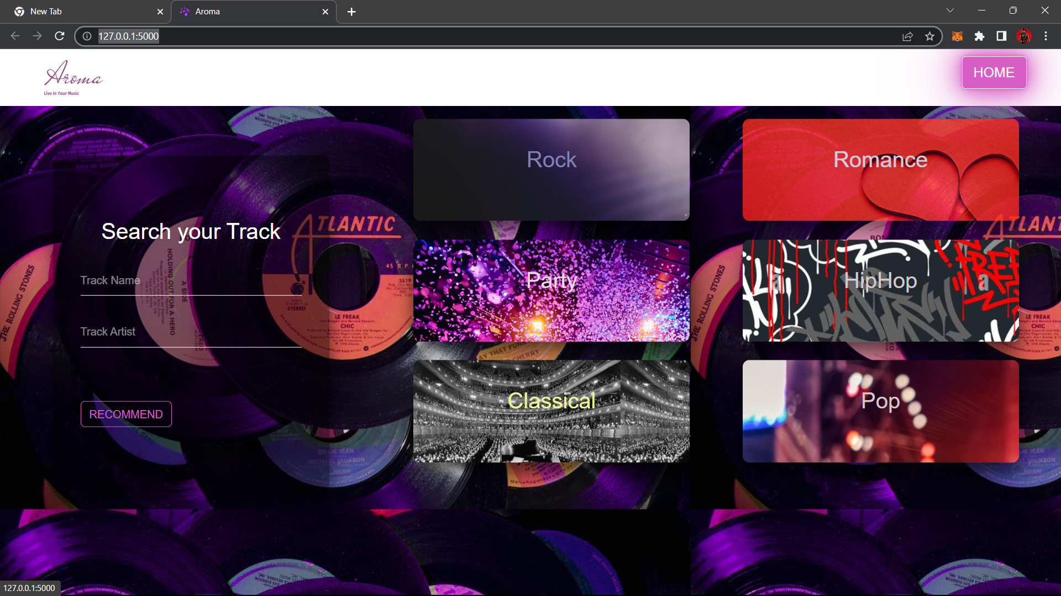
Web Application
19

Slide 20
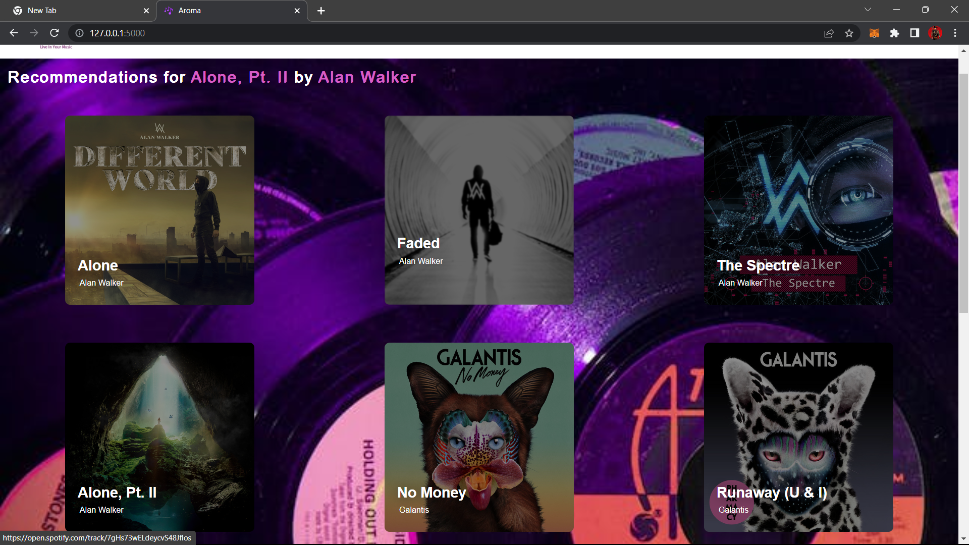
Web Application
20

Slide 21

Let’s review our learnings
Conclusion
Machine Learning
Business Domain
Data
More data is better
Sample the data for Grid Search
Feature Engineering is important
Dropping features manually for regularization
Different feature engineering for different model (No Free Lunch)
Ensembling
Ensembling works if models are different
Feature
Even counts are important
User level Personalization is required
Model
Find model performance correlations
Select fewer important parameters
Feature importance helps interpretation
Make hypothesis and demonstrate
21

Slide 22

Thank You
Any questions?
Presented by The
Placeholders
Github: https://github.com/SOVAN2003/Aroma
22

